Slide 1
GenAI HW2 都是AI的作文比賽
TA: 陳瑋智、謝承修、呂俐君
ntu-gen-ai-2024-spring-ta@googlegroups.com
Deadline: 2024/03/21 23:59:59 (UTC+8)

Slide 2
Outline
Links
Task Description
Workflow
Grading Policy
Important Dates
Regulations
NTU Cool HW2 Forum
MediaTek DaVinci
OpenAI ChatGPT
Anthropic Claude
Google Gemini
Microsoft Copilot

Slide 3
Task Description

Slide 4
都是AI的作文比賽: 參賽者跟評審都是AI
There are two parts in this assignment: Writing essays and judging the essays
You will use AI models to generate two essays
You will use AI models to evaluate the essays
Notes:
There are two parts in this assignment: Writing essays and judging the essays 这项作业分为两部分：撰写论文和评判论文
You will use AI models to generate two essays 你将使用 AI 模型生成两篇论文
You will use AI models to evaluate the essays 你将使用 AI 模型评估论文

Slide 5
Workflow

Slide 6



Workflow
Ask Language Models to write it
Platforms
OpenAI - ChatGPT
MediaTek DaVinci（達哥）
Others
1. Generate an essay
Write it on your own
Any other methods
2. Evaluate your Essay
We use generative AI as a TA to evaluate your essay automatically.
AI
Generative AI TA [批改助教] Info :
1. Platform: MediaTek DaVinci
2. Model: GPT-4
3. Submit to NTU COOL

Slide 7
Part 1. Generate Two Essays with AI Models

Slide 8
Workflow
Ask Language Models to write it
Platforms
OpenAI - ChatGPT
MediaTek DaVinci（達哥）
Others
1. Generate an essay
Write it on your own
Any other methods
2. Evaluate your Essay
We use generative AI as a TA to evaluate your essay automatically.
AI
Generative AI TA [批改助教] Info :
1. Platform: MediaTek DaVinci
2. Model: GPT-4
3. Submit to NTU COOL

Slide 9
Short Essay Writing — English
Do you agree or disagree with the following statement?
Artificial Intelligence will eventually replace humans in most areas of work in the future world
Write an English essay with around 300 words to express your stance with
specific reasons and examples to support your answer
Notes:
Do you agree or disagree with the following statement? 你是否同意以下说法？
Artificial Intelligence will eventually replace humans in most areas of work in the future world 在未来的世界里，人工智能最终将在大多数工作领域取代人类
Write an English essay with around 300 words to express your stance with specific reasons and examples to support your answer 写一篇300字左右的英语短文，用具体的理由和例子来支持你的答案

Slide 10
Short Essay Writing — Mandarin
參考 113學年度學科能力測驗試題 國語文寫作能力測驗 第二部分 所附的文章，
請以「縫隙的聯想」為題，撰寫一篇約五百字的繁體中文文章，
並結合生活經驗或見聞，書寫你的感思與體悟。

Slide 11

Sample Methods to Prompt AI
Directly use the task description:
Describe your needs:
Role-playing:
Any other creative prompts are welcome.
Write an essay with the topic {Topic}.
Write a 3-paragraph essay about {Topic}. Please use a professional tone.
You are a perfect writer. Please write an essay about {Topic}.
Replace {Topic} above with your chosen topic
Notes:
Write a 3-paragraph essay about {Topic}. Please use a professional tone. 写一篇关于{Topic}的三段文章。请使用专业的语气。
You are a perfect writer. Please write an essay about {Topic}. 你是一个完美的作家。请写一篇关于{主题}的文章。

Slide 12
Short Essay Writing
We expect you use generative models to complete this assignment,
although it is permissible if you prefer to compose them manually
Editing the generated essays is allowed
Editing the essays that you wrote with AI is allowed
Notes:
We expect you use generative models to complete this assignment, 我们希望你们用生成模型来完成这个作业，
although it is permissible if you prefer to compose them manually 尽管如果您喜欢手动组合它们也是允许的
Editing the generated essays is allowed 允许编辑生成的文章
Editing the essays that you wrote with AI is allowed 允许用人工智能编辑你写的文章

Slide 13
Part 1-a. Generate An Essay with ChatGPT

Slide 14
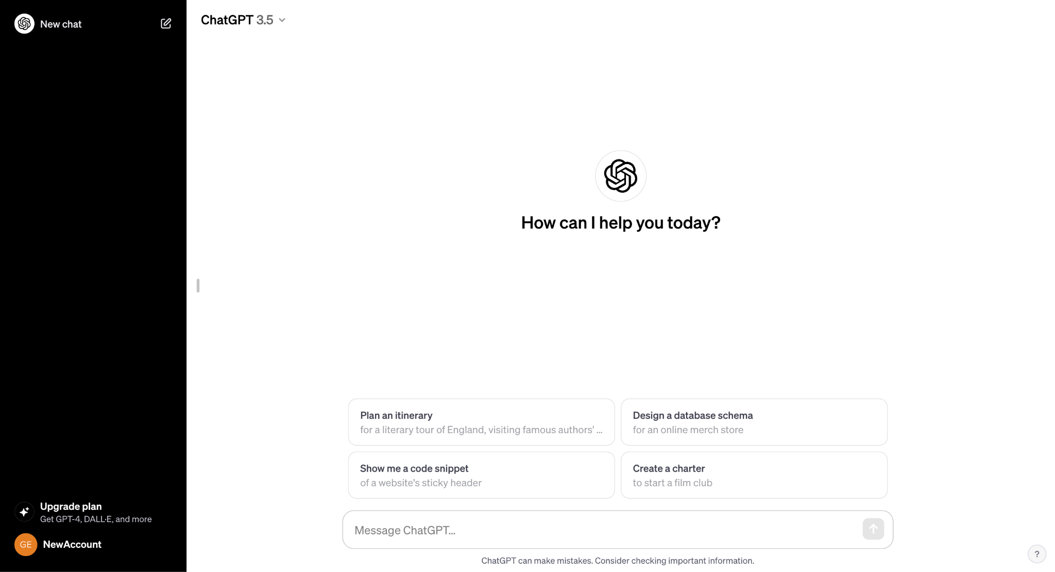
Click here to start a fresh conversation
Type a message here to interact with ChatGPT

Slide 15
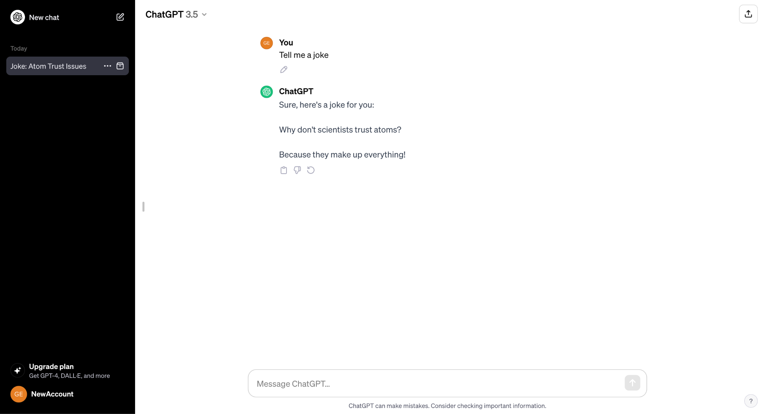
Share link to chat →
← Edit the message and regenerate a response
Copy the response →
← Regenerate ChatGPT’s response

Slide 16
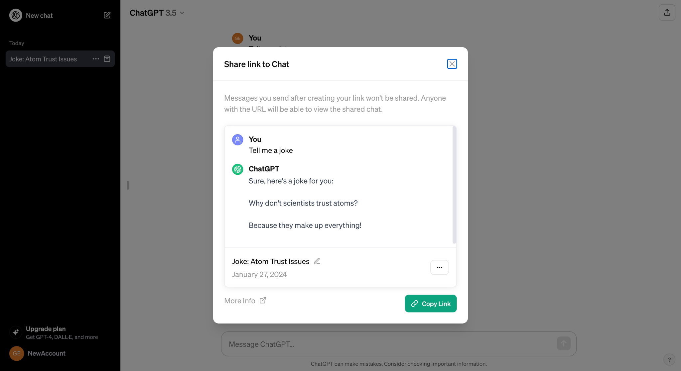
Click here to copy →

Slide 17
Part 1-a. Generate An Essay with ChatGPT: Demo

Slide 18
OpenAI ChatGPT Tutorial
Click here to load ChatGPT

Slide 19
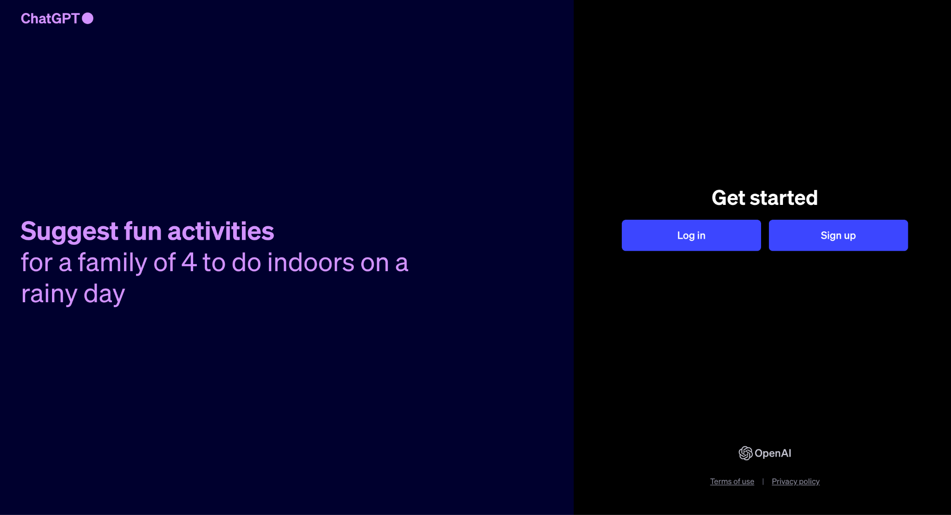
Here to create your account

Slide 20
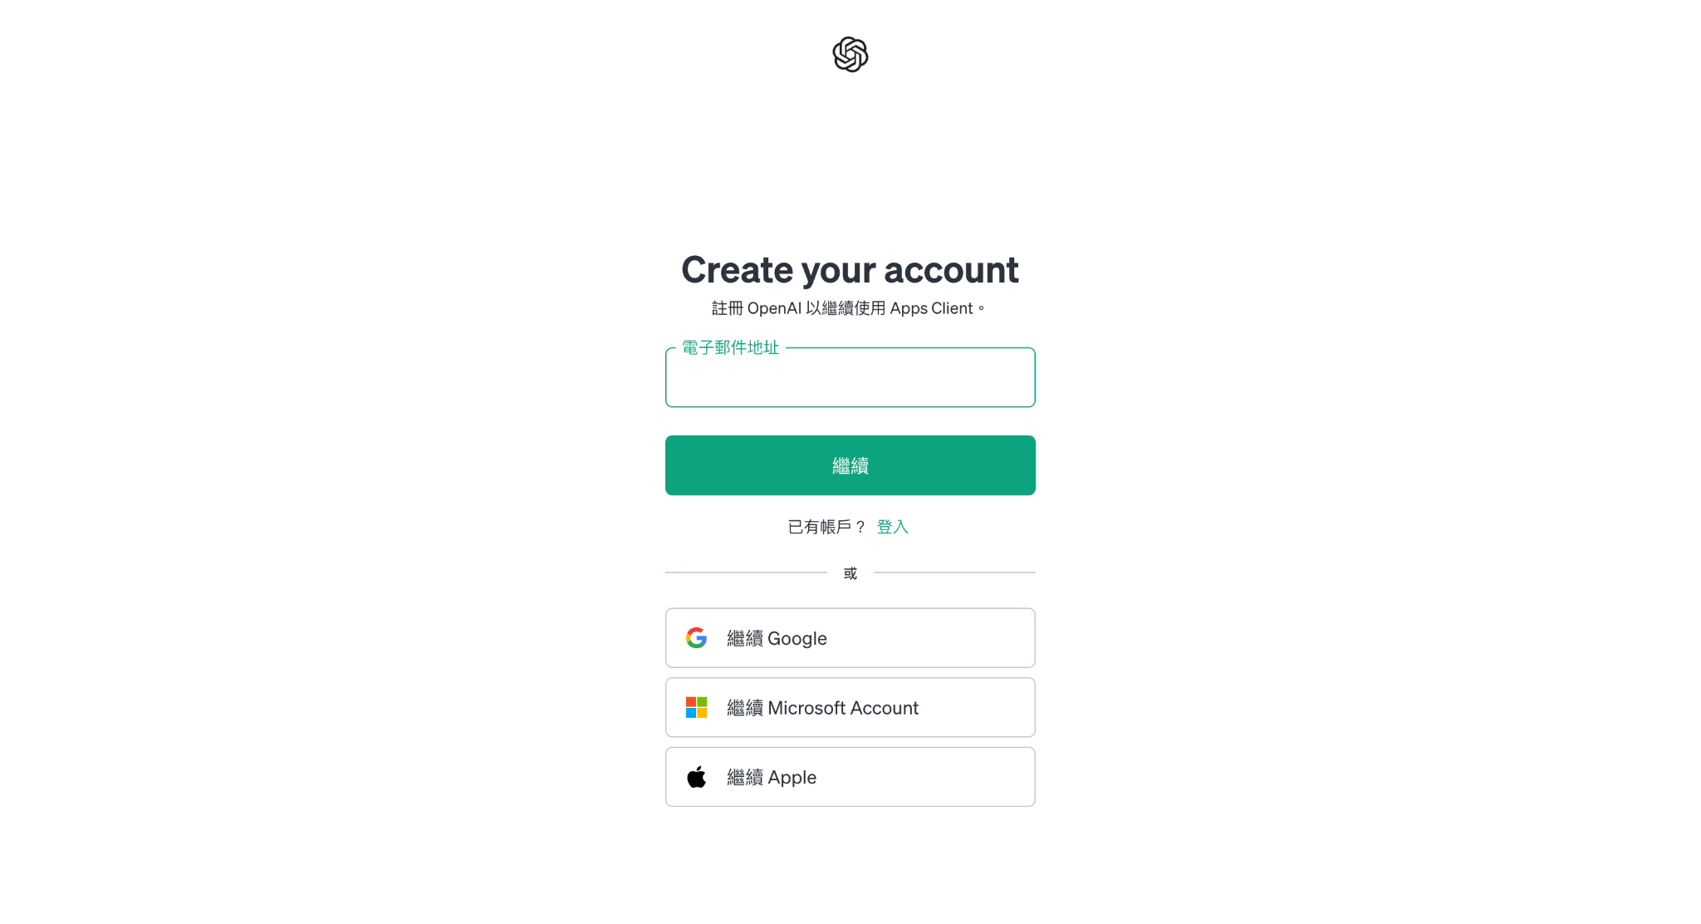
Enter your email here
or log in with existing accounts →

Slide 21
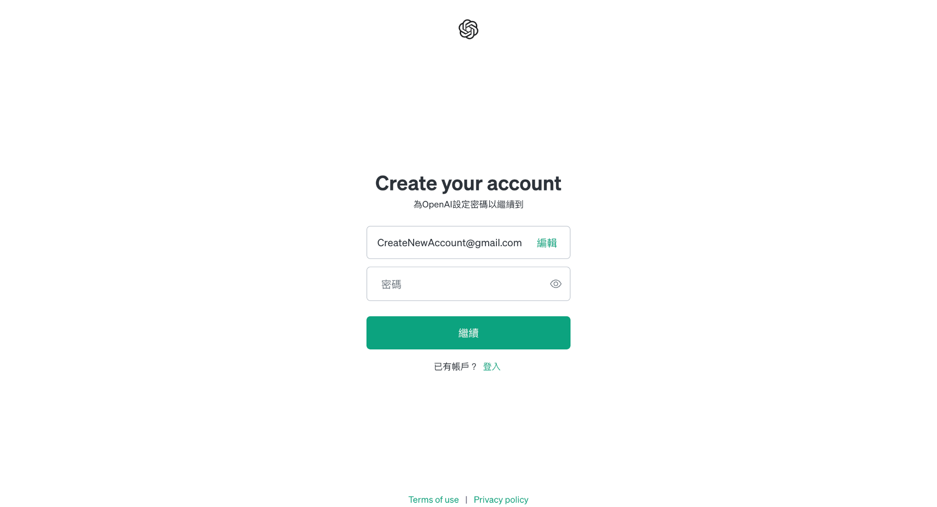
Create a password →

Slide 22
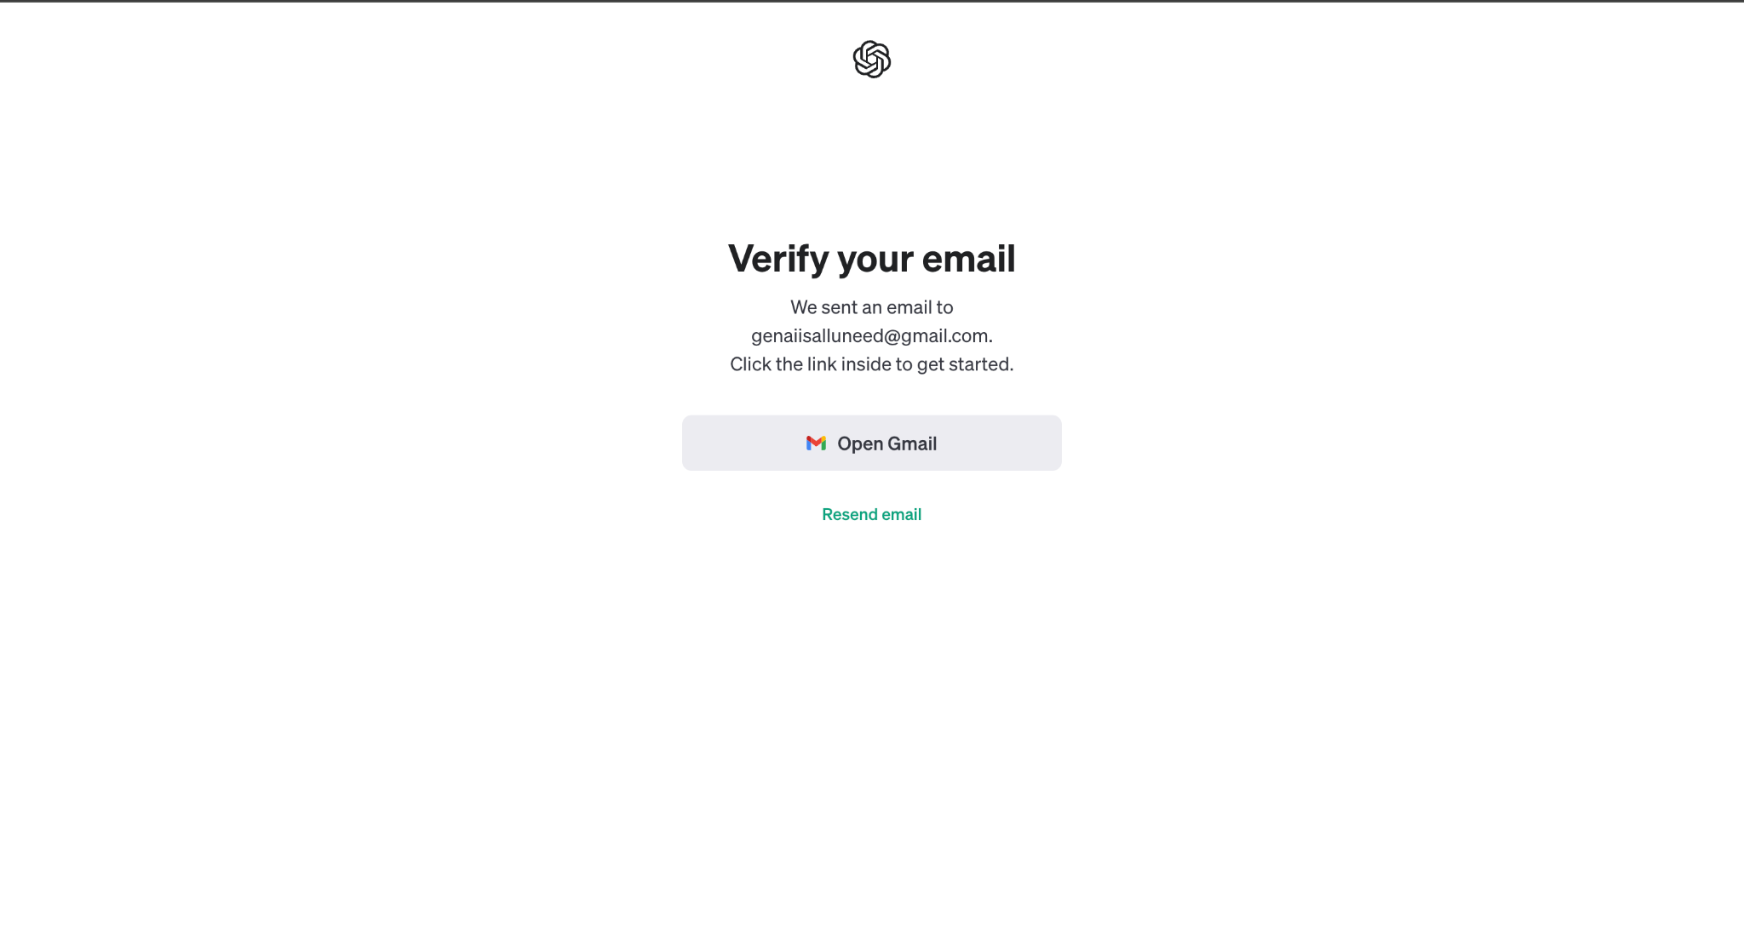
Check your email inbox for a verification email from OpenAI

Slide 23
Part 1-b. Generate An Essay with DaVinci

Slide 24
MediaTek DaVinci Platform
DiVinci (達哥) is a platform provided by MediaTek that hosts different AI models, including GPT-3.5 and GPT-4

Slide 25
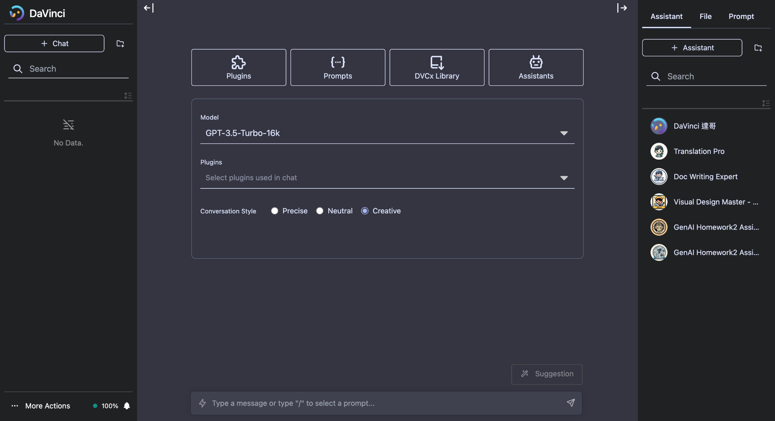
1. Create a new chat
2. Select a model
(Models has different pricing criteria)
3. Select a Conversation Style
Precise - Always generates the same response for a given input
Neutral - Balances between precision and creativity
Creative - Encourages diversity and novelty
⚠️ Composing essays on DaVinci will
consume your daily usage quota.
Remaining daily usage quota
4. Type your message here
5. Send

Slide 26
Part 1-b. Generate An Essay with DaVinci: Demo

Slide 27
MediaTek DaVinci Tutorial
Click here to load DaVinci platform

Slide 28
DaVinci Chatbot Account Registration
For registered students,
You will receive the registration letter after 3/4 if you joined NTU Cool before noon on 3/1.
Otherwise, your account will be activated after 3/4.
⚠️ Please contact TAs if you haven’t received a registration letter by 3/8.

Slide 29

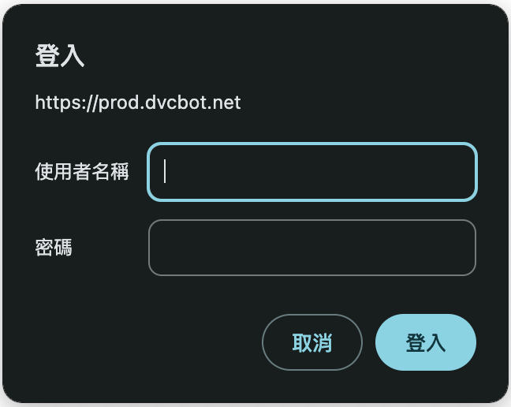
Login
Your account should be set up through the email you provided.
If you do not reset the password within 72 hours, the account will be invalid.
This service is only open to registered students.
Student_ID@ntu.edu.tw

Slide 30
Part 2. Evaluate the Essays Using AI Models

Slide 31
Workflow
Ask Language Models to write it
Platforms
OpenAI - ChatGPT
MediaTek DaVinci（達哥）
Others
1. Generate an essay
Write it on your own
Any other methods
2. Evaluate your Essay
We use generative AI as a TA to evaluate your essay automatically.
AI
Generative AI TA [批改助教] Info :
1. Platform: MediaTek DaVinci
2. Model: GPT-4
3. Submit to NTU COOL

Slide 32



Essay Evaluation
In the past, the evaluation of essays are done by humans
The student writes an essay
The teacher (human) evaluates the essay based on some criteria
Obtain the evaluation result

Slide 33


Essay Evaluation
In this homework, the evaluation of essays are done by AI assistants
The student writes an essay with AI
The AI assistant evaluates the essay based on some criteria
Obtain the evaluation result

Slide 34

Essay Evaluation
We employ evaluation assistants (批改助教) on MediaTek DaVinci platform
We prepare evaluation prompts including evaluation criteria and steps
We combine an essay with the evaluation prompt and submit it to the assistant to obtain a score
Evaluation Prompt + Essay
Evaluation Assistant
Assessment Result (Score)

Slide 35
Essay Evaluation
Illustration of the evaluation by AI evaluation assistant
You are tasked with evaluating an article that presents the statement "Do you agree or disagree with the statement that Artificial Intelligence will eventually replace humans in most areas of work in the future world."
Your assignment involves assessing the article based on various criteria.
It is essential to thoroughly read and comprehend these instructions. Keep this document accessible during your review and refer to it as necessary.
Evaluation Criteria:
Ideas and Analysias (30%):
Evaluate the strength and depth of the article's ideas. Consider the analysis provided, the clarity of the main argument, and the overall coherence of the author's viewpoint.
(...)
Student's Essay:
<Essay to be evaluated>
Final
score:
7.5
Evaluation assistants

Slide 36
Evaluation Settings in Evaluation Assistants
Platform
MediaTek DaVinci Platform
Model
GPT-4-turbo
Hyperparameters
Temperature 0.5 (Neutral)

Slide 37
Evaluation Prompts
Due to the limited space, we put the full version of evaluation prompts below
English
Mandarin
Please contact TAs immediately if the links are not accessible.
⚠️ TAs have made some modifications to the evaluation prompts in response to students' concerns regarding prompt hacking. [Update on 3/1]

Slide 38
Part 2. Evaluate the Essays on DaVinci Platform
Step 1: Install Evaluation Assistants

Slide 39
Evaluation Assistants
In Homework 2, you need two evaluation assistants:
GenAI Homework2 Assistant (English)
for English essay evaluation
GenAI Homework2 Assistant (Mandarin)
for Mandarin essay evaluation
⚠️ Please utilize the appropriate assistant to evaluate your essays. Otherwise, your evaluation results will be deemed invalid and you will not receive any score.

Slide 40
1. Create a new chat
2. Check assistant store

Slide 41
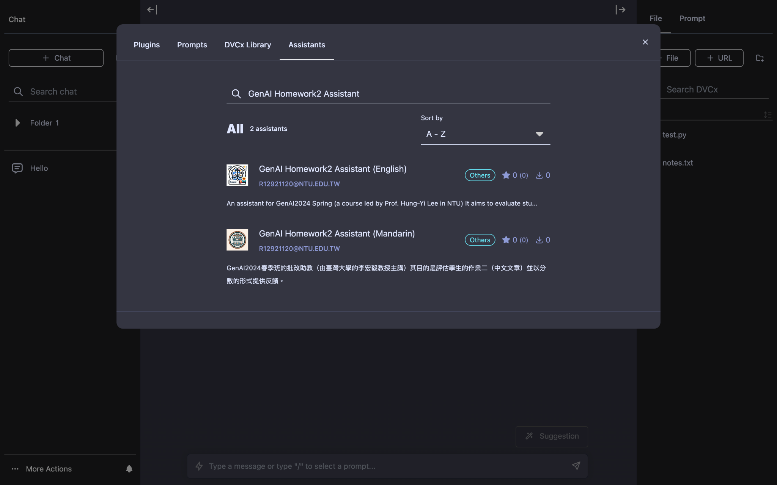
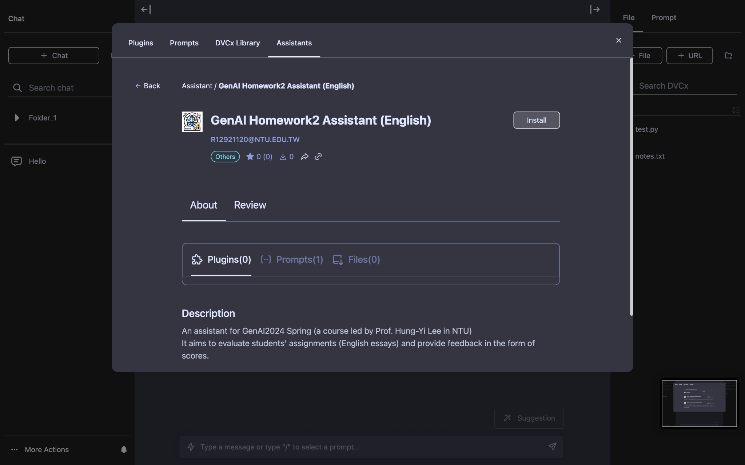
3. Search the name of the assistant
4. Click your target assistant
5. Install

Slide 42
Part 2. Evaluate the Essays on DaVinci Platform
Step 2: Use Assistants to Evaluate Essays

Slide 43
1. Create a new chat for each essay evaluation
2. Check the installed assistants
3. Click your target assistant
(GenAI Homework2 Assistant)
⚠️ Ensure to open a NEW chat every time you re-evaluate the result

Slide 44
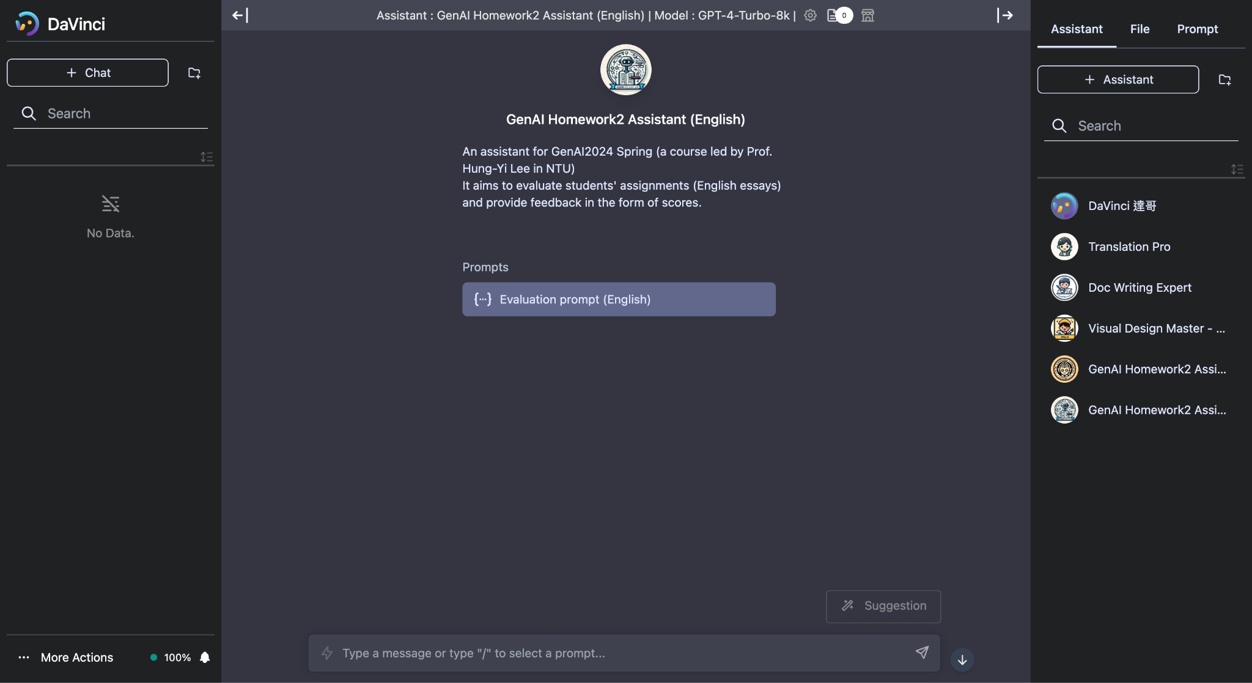
4. Use the evaluation prompt to evaluate your essay

Slide 45
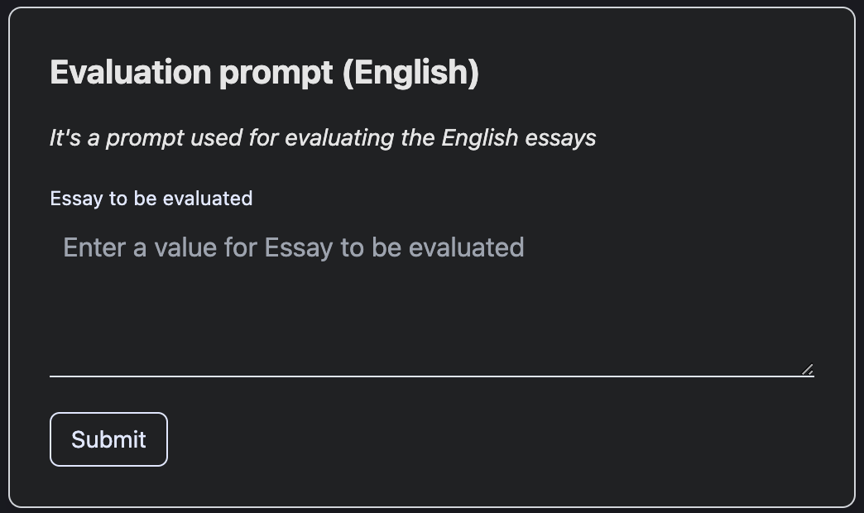
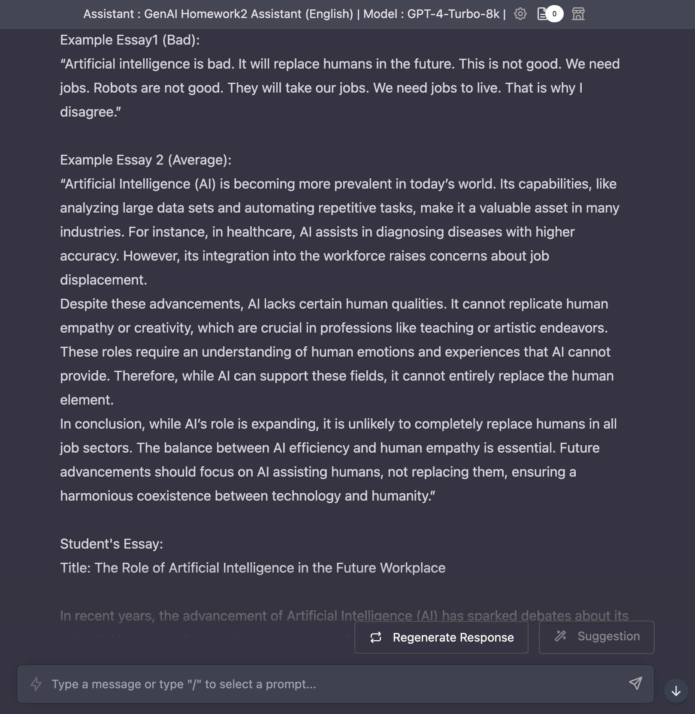
It will automatically generate a prompt with your essay contained as the input to the assistant
5. Put your FULL essay here
6. Click submit
⚠️ Submitting the essay each time uses up your daily quota. About 10 essay evaluations can be conducted in total each day.

Slide 46
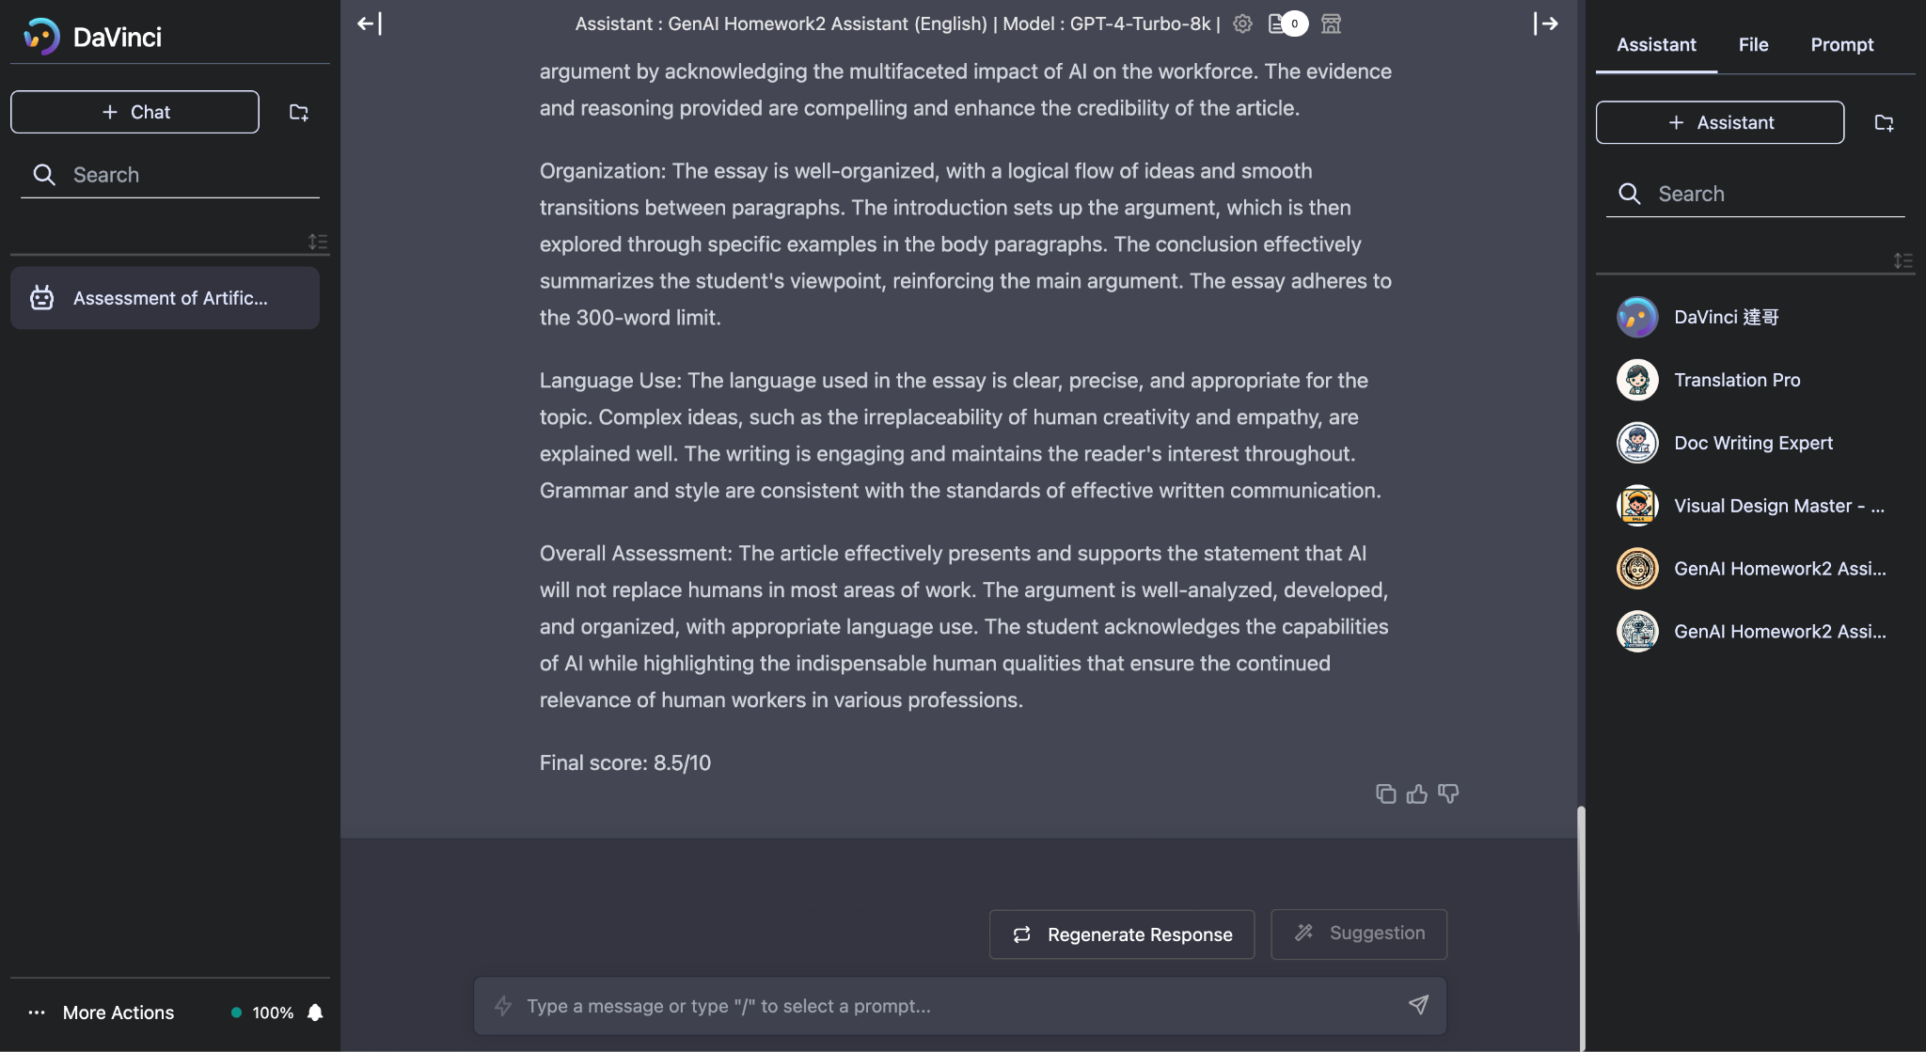
7. Assistant gives feedback and a final score for your essay

Slide 47
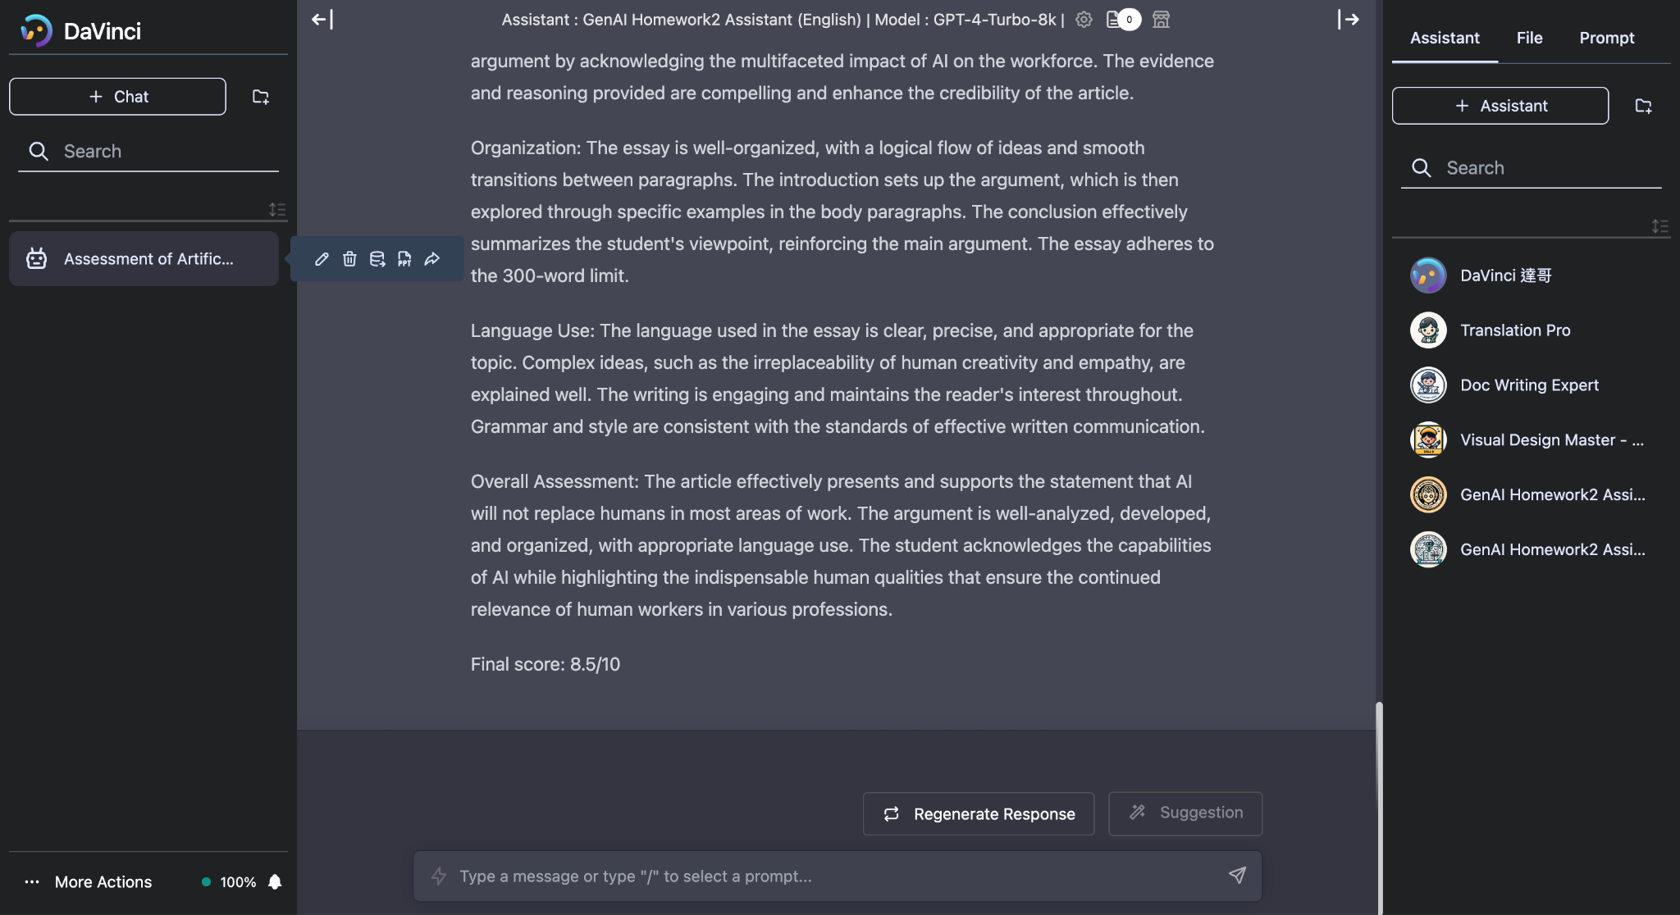
8. Export the result into a JSON file
⚠️ If there are good results, you can save them first to avoid any unexpected circumstances.

Slide 48
Part 2. Evaluate the Essays Using AI Models: Demo

Slide 49
Part 3. Submit to NTU Cool

Slide 50
Workflow
Ask Language Models to write it
Platforms
OpenAI - ChatGPT
MediaTek DaVinci（達哥）
Others
1. Generate an essay
Write it on your own
Any other methods
2. Evaluate your Essay
We use generative AI as a TA to evaluate your essay automatically.
AI
Generative AI TA [批改助教] Info :
1. Platform: MediaTek DaVinci
2. Model: GPT-4
3. Submit to NTU COOL

Slide 51
Submission (NTU Cool)
Complete the Quiz HW2 on NTU Cool
Ensure to submit your evaluation result in JSON format
Submitting in the wrong format equals non-submission
No restrictions on upload quota
But only the most recent submission will be kept
No late submission is allowed
⚠️ We will compare the files you submit with our backend data records to ensure they match. Therefore, please do NOT manually edit your JSON file.

Slide 52
Quick Demonstration

Slide 53
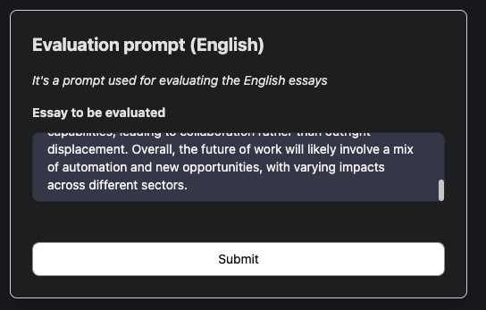
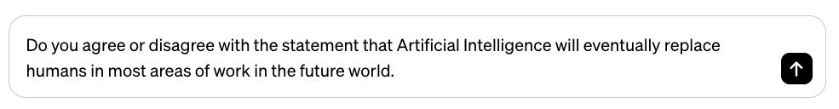
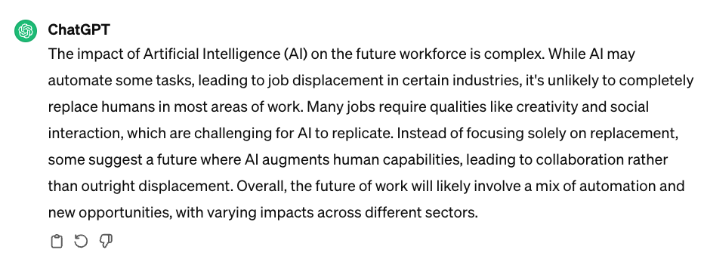

Quick Demonstration
Use any platform to generate an essay. (Here we use ChatGPT as example)
Evaluate the essay by GenAI Homework2 Assistant. (on DaVinci Platform)
If you are satisfied with the result, download the json file and submit it.
Try different prompt here!
Submit json file

Slide 54
Grading Policy

Slide 55
Point Distribution
Homework 2 accounts for 10 points in total
(3pts) NTU Cool Submission
You need to complete the entire quiz to get full credit
(7pts) Assessment of two essays
3.5 points for each essay

Slide 56
Grading — English Essay
Essay Score Homework Score
9.5 — 10.0 +3.5 pts
8.5 — 9.4 +3.0 pts
8.0 — 8.4 +2.5 pts
7.5 — 7.9 +2.0 pts
7.0 — 7.4 +1.5 pts
6.0 — 6.9 +1.0 pts
Otherwise +0.0 pts

Slide 57
Grading — Mandarin Essay
Essay Score Homework Score
Rank A+ +3.5 pts
Rank A +3.0 pts
Rank B+ +2.5 pts
Rank B +2.0 pts
Rank C+ +1.5 pts
Rank C +1.0 pts
Otherwise +0.0 pts

Slide 58
Important Dates

Slide 59
Important Dates
Deadline for Submission (NTU Cool) [Update on 3/1]
2024/03/21 23:59:59 (UTC+8)
Grading Release Date
2024/04/04 23:59:59 (UTC+8)

Slide 60
Regulations

Slide 61
Regulations
Plagiarism in any form is prohibited.
Do NOT share your prompts and evaluation results (JSON files) with others.
Do NOT submit the JSON files that are not obtained using your Davinci account
Do NOT attempt to manually edit your JSON files.
第一次違反以上規定，該作業0分，學期總成績再乘以0.9
第二次違反以上規定，學期成績F
Prof. Lee & the TAs preserve the rights to change the rules & grades.

Slide 62
If You Have Any Questions
NTU Cool HW2 Forum
Recommended if no assignment answers or privacy issues are involved in your questions
Prioritize answering questions on the homework forum
Email: ntu-gen-ai-2024-spring-ta@googlegroups.com
Title should start with [GenAI 2024 Spring HW2]
Email with the wrong title will be moved to trash automatically
TA Hours
Time: 3/1、3/8、3/15 (16:30 - 17:20)
Location: 綜合大講堂

Slide 63
Reminders for using DaVinci platform
There is a daily usage quota limitation on the DaVinci platform
Each time you use the platform to generate or evaluate something, it consumes your quota
For evaluating essays using the evaluation assistant: Approximately 10 essay evaluations can be conducted in total per day (if you do not use DaVinci to do anything else)
For generating essays: Approximately 500 essays can be generated using GPT-3.5 model. Using the GPT-4 model will incur higher expenses. (20x expensive than GPT-3.5)

